Slide 1


Software Course Management System

Slide 2
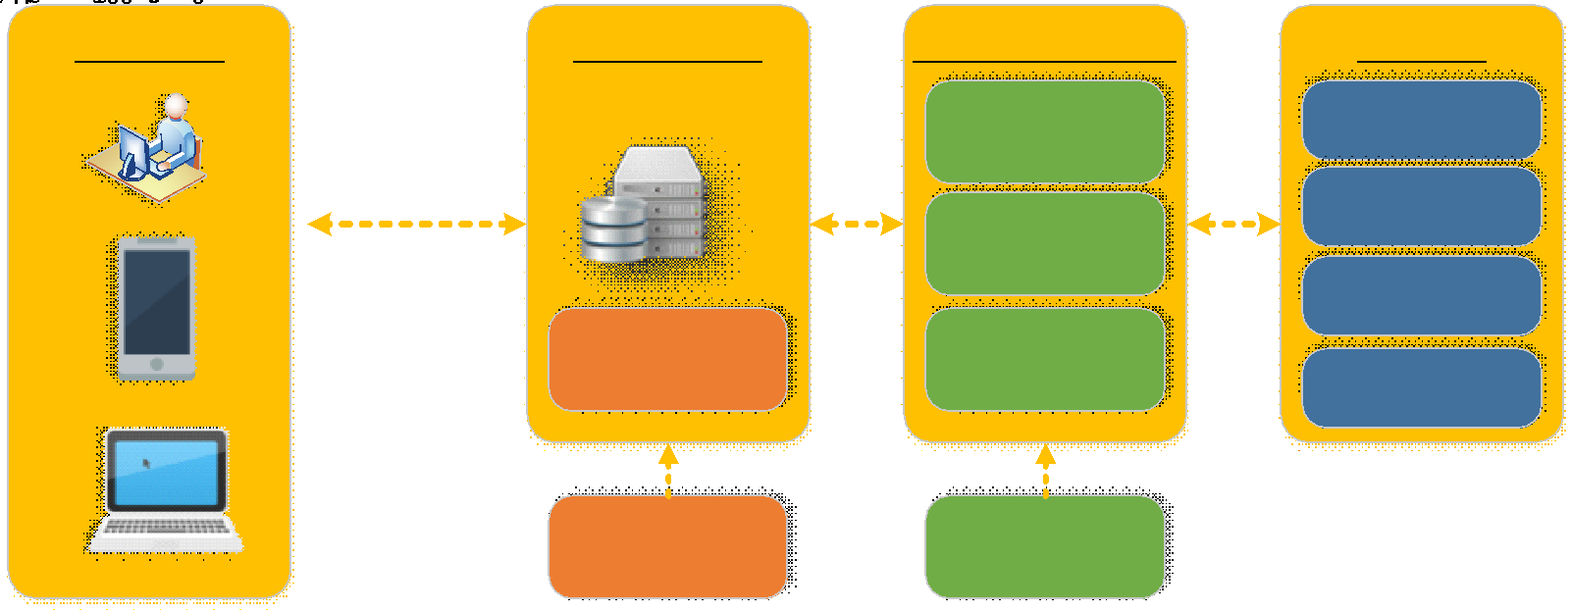

Slide 3
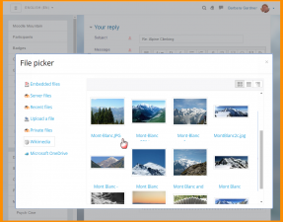
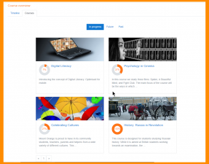

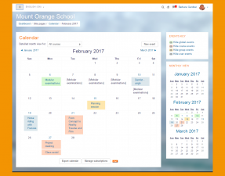
General Features
Modern, easy to use interface
Personalised Dashboard
Collaborative tools an activities
All-in-once Calender
Convenient file management
Simple and intuitive text editor
Notofications
Track progress

Slide 4
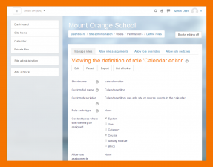
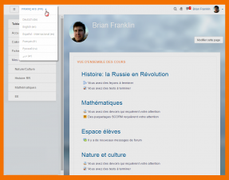
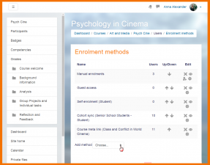
Administratif Features
Custumisable site design and layout
Secure authentication and mass enrolment
Multilangual capability
Bulk course creation and easy backup
Manage user roles and permissions
Support open standards
High interoperability
Simple plugin management
Regular security updates
Detailed reporting and logs

Slide 5
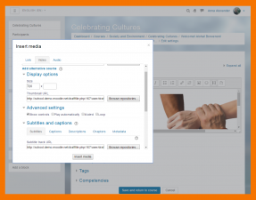
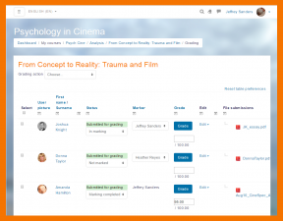
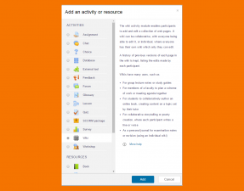
Course Development and Management Features
Direct learning paths
Encourage collaboration
Embed external resources
Multi media integration
Group management
Marking workflow
In-line marking
Peer and self assesment
Integrated Badges
Outcomes and rubrics
Competency based marking
Security and privacy

Slide 6
LOGO INNOV
In diesem Teil der Präsentation kannst du dich vorstellen, deine E-Mail-Adresse schreiben...

